Slide 1
Battle of zip codes – charlotte
Coursera Data Science Captstone Project

Slide 2
Introduction
Problem Statement
Provide a recommendation for our client on the best zip code to open a new restaurant in Charlotte NC
Our client wants to open a high end Indian restaurant
Profitability and success are the goals for the restaurant
Objective
Develop a model to recommend best zip code to open a restaurant
Keep the model flexible enough to tweak to provide new recommendation, if restaurant concept were to change
Use multiple dimensions/features to provide better accuracy
If needed, be able to provide the next best option

Slide 3
Data Used
Demographics
Zip code, Population, Population Density, median home value, median home income
Safety/Crime data
Identify crime incidents by zip code to determine safety of each zip code
Economic activity in the area
Measure economic activity/spending by zip code. High spending zip codes may lend themselves better for a restaurant
Competition
Understand current competition and identify any sweet spots.
Approach
Collect data for each of the dimensions above
Clean/wrangle data. Make appropriate assumptions where data is not available
Normalize data in relation to population of the zip code if appropriate.
Cluster each zip code using K-means Clustering on the four dimensions of data, where available
Assess all clusters on the four dimensions to identify the best zip for the restaurant

Slide 4
Data Sources
Demographics
Sourced from US Zip Codes package in Python
Zip code, Population, Population Density, median home value, median home income
Safety/Crime data
The City of Charlotte does not have all the crime data openly available to public. However, they do have three APIs/files for the three categories below
CMPD Officer-Involved Shootings – Individuals here
CMPD Officer Involved Shootings – Officers here
CMPD Officer-Involved Shootings – Incidents here
Economic activity in the area
Used Shopping Centers statistics as proxy
Data is sourced from here
Competition
Sourced list of restaurants and categories of those restaurants from FourSquare API
Note on Visual representation of data
Size of the circle on the map indicates importance of the dimension
Circles are centered on the zip codes
Color of the circle indicates our recommendation for that dimension
Dark Green – Strong Yes, Green – Yes, Yellow – May be and Red - No

Slide 5
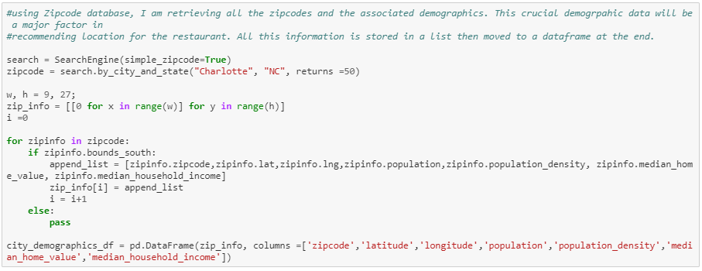
Demographic Clustering
Pull necessary data from USZipcode package in python
Discard zip codes that have less than 100 households for consideration
For each zip get latitude and longitude to represent the zip on the map

Slide 6
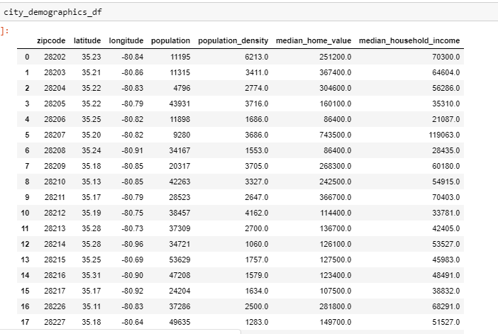
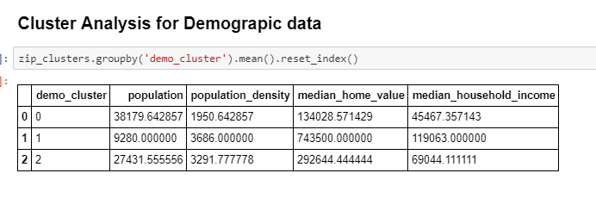
Demographic Clustering
Sample Demographics data before clustering
Cluster #0 - Low Income Low Density - Lean would be No
Cluster 1 - High Density High Income - Lean is Strong Yes
Cluster 2 - High Population Medium Income – Yes

Slide 7
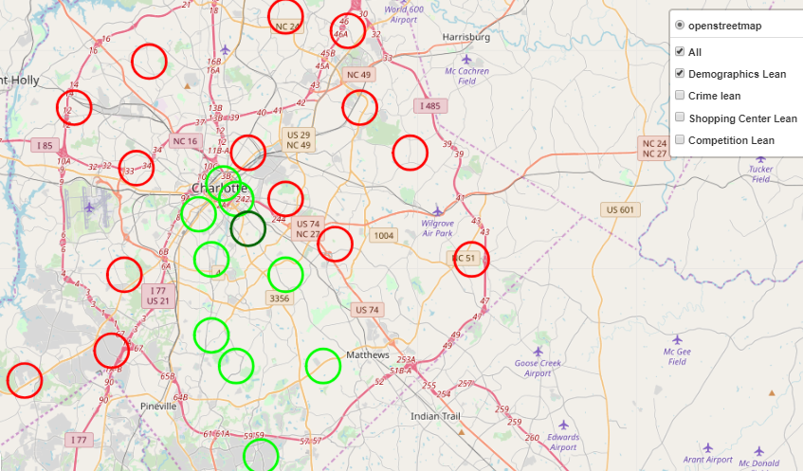
Demographic Clustering
Uptown (epicenter of the city) and South of Charlotte are favored 28207 got a Strong Yes (Cluster #1) See the Jupyter notebook for info on cluster labeling

Slide 8
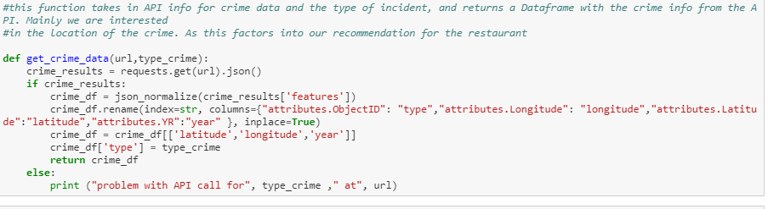
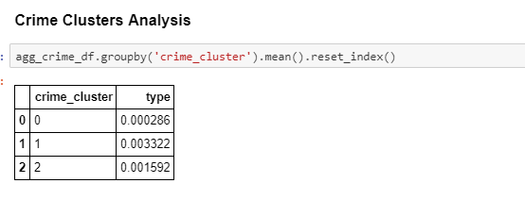
Crime/Safety Clustering
Used one function to get data from all 3 APIs
Primary purpose is to calculate number of incidents by zip code
Cluster 0 - Low Crime - Yes
Cluster 1 - High Crime – No
Cluster 2 - Medium Crime - Maybe

Slide 9
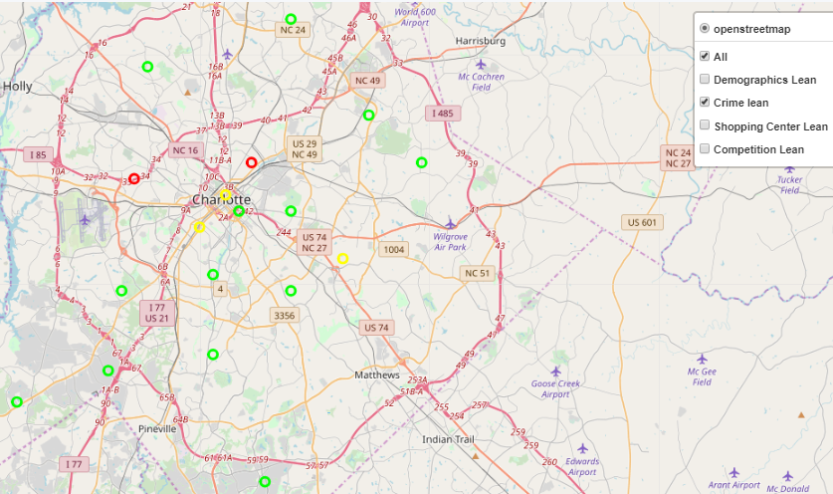
Crime/Safety Clustering
Crime rate is high or medium close to the epicenter of the city
Looks pretty safe everywhere else
Note that this is based on limited data available from Charlotte Open Data portal
Size of circles on the map implies weightage for this particular aspect
Colors indicate our recommendation disposition

Slide 10
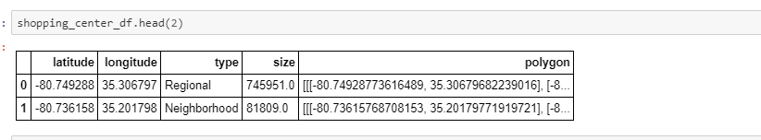
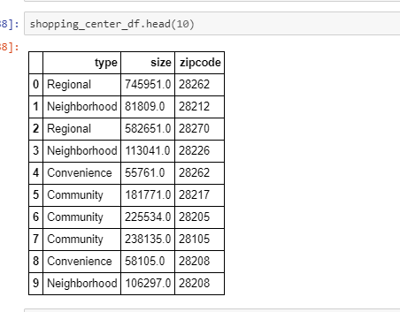
Shopping Center Data Analysis
We want to look at type of shopping centers and their size by zip code
Since zip code is not available, we extract latitude, longitude from shape data in the API

Slide 11
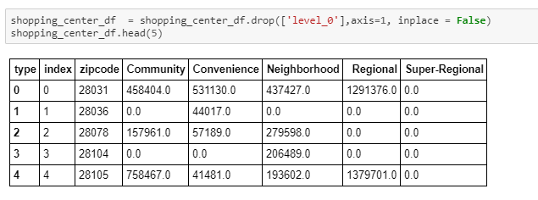
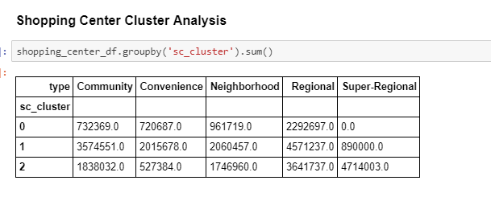
Shopping Center Data Analysis
Data is transposed before we standardize and cluster
Shopping Centers are clustered into three
Cluster 0 - Less Desirable (Maybe)
Cluster 1 - Desirable (Yes)
Cluster 2 – Desirable (Yes)

Slide 12
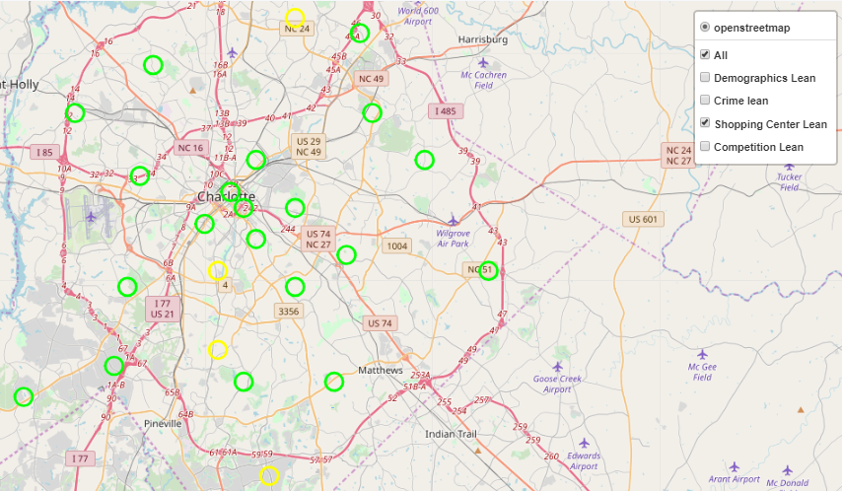
Shopping Center Data Analysis
Most zip codes where data is available are rated favorably except some in south and north of epicenter

Slide 13
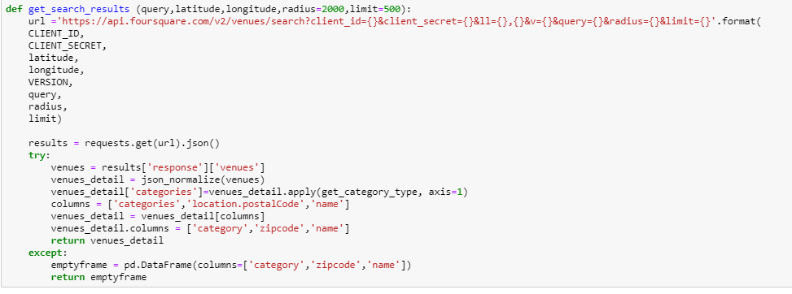
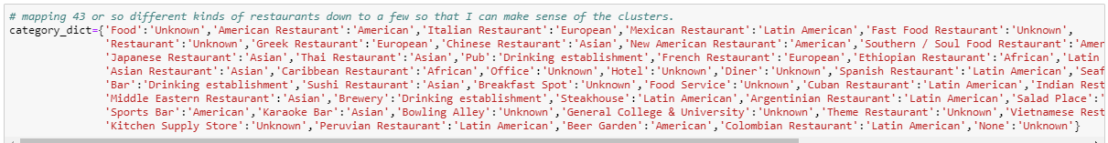
Competition
Use FourSquare to get restaurants and their category in all Zipcodes in Charlotte
Condense 43 categories to 7 categories to interpret clustering meaningfully

Slide 14
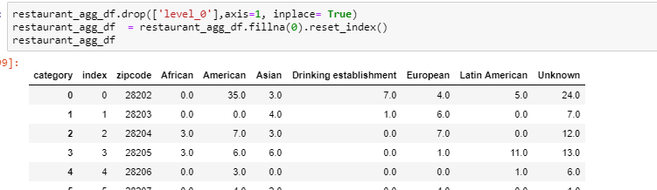
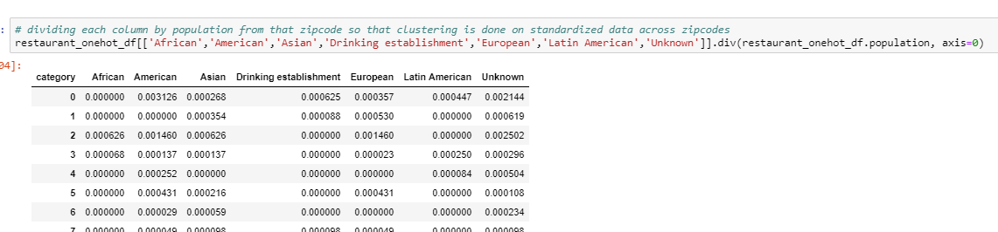
Competition
Aggregate restaurant information by Category
Normalize number of restaurants to population before using standard scaler for clustering

Slide 15
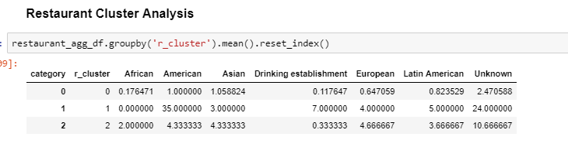
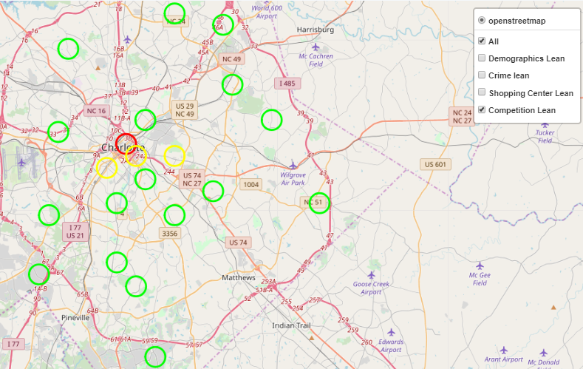
Competition
Cluster 0 – Few Restaurants – Yes
Cluster 1 – Crowded – No
Cluster 2 – Too many Asian Restaurants - Maybe

Slide 16
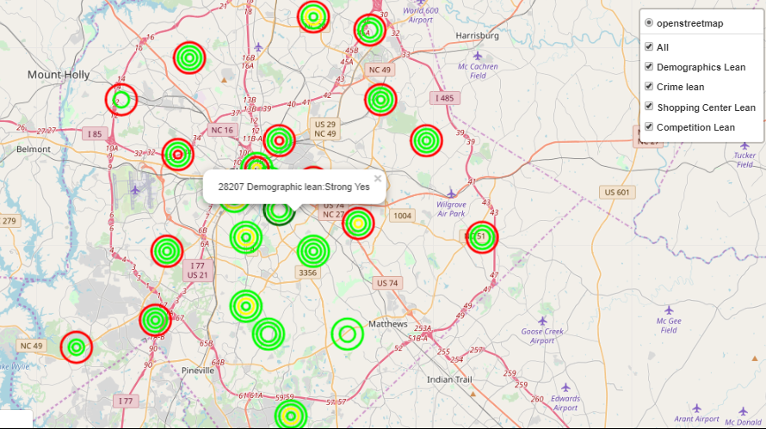
Bringing it all Together
There are three zipcodes for which all 4 dimensions are rated favorably
28207 takes the lead as demographic lean (the most important dimension) is rated most favorable among all
28211 and 28226 follow behind 28207
Note that No crime data for these zip codes is positive (that means no incidents occurred in these zip codes)

Slide 17
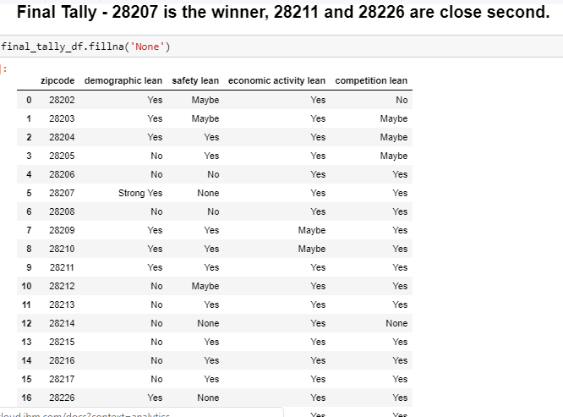
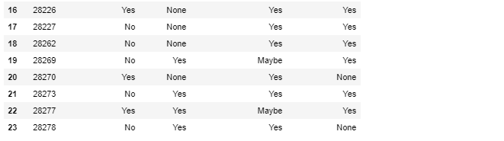
Bringing it all Together – Tabular form

Slide 18
Caveats
We could use PAC (probably approximately correct) learning to condense number of variables we used in clustering. I know such thing existed, but did not have time to learn about it, yet.
Population and Population density may not always tell the story. For example, uptown of the city is mostly office space that represents tremendous opportunity for a restaurant (as rightly reflected by the # of restaurants in the area). But our model tell us to avoid uptown. While this still could be correct, more research need to be done.
Weightage for each dimension are subjective. So is disposition we assigned for each cluster
It is entirely possible and probably true that this is a truly novice version and there are far better methods and models to solve this problem.

Slide 19
Appendix
Link to the Jupyter Notebook to see the code and maps: https://dataplatform.cloud.ibm.com/analytics/notebooks/v2/750ca25b-69e8-422b-8a80-2b5986f3acd2/view?access_token=619a8df1f4af52235d763ce442bcda894ea18137cb1b8dd3ae99c739112ec6aa
Link to Github page:

